Slide 1
Github 101
An overview
Notes:
House keeping items:
My goal today is to make sure knowledge transfer, as a result, I will be spot checking for your understanding. My expectation is that you answer back with a summary of what you have learned so far. Silence as answer will trigger to repeat the knowledge until a summary is provided.

Slide 2
Today topics:
What, Why and Benefits of source control
Tools available
Basic concepts
Creation of repository
Installation @ client side
Adding files to repository
Extracting code from the repository
Obtaining help

Slide 3
What is version control?
System used to the management of changes to documents, computers programs. Large web sites, and other collections of information.

Slide 4
Why source control?
To bring teams together to work through problems in a collaboration fashion, move ideas forward, and learn from each other along the way, Snapshots of all versions are properly documented and store, help to analyze projects.

Slide 5
Benefits:
It helps to write better code.
Manage chaos by involving the right resource to mitigate it.
Easy access to tools by discovering new favorites and start using them in minutes
Code security and access controlled.

Slide 6
Must common used tools:
Git
Subversion
CVS
Mercurial.

Slide 7
Basic concepts
Github: it is the central repo. It is a company that allow you to host your central repo in a remote server.
Git: tool that will allow you to create your local repo. It is a version control management tool. It will allow you to fetch and push data to/from the central repo. Git supports distributed non-linear data assurance for developing quality software.
Git features: distributed, compatible, non-linear, branching, lightweight, speed, open source, secure, economical, reliable.

Slide 8
Basic concepts
Repository: a directory or storage space where your projects can live. It can be local to al folder on your computer, or it can be in the cloud storage space on GitHub

Slide 9
Hands on training

Slide 10
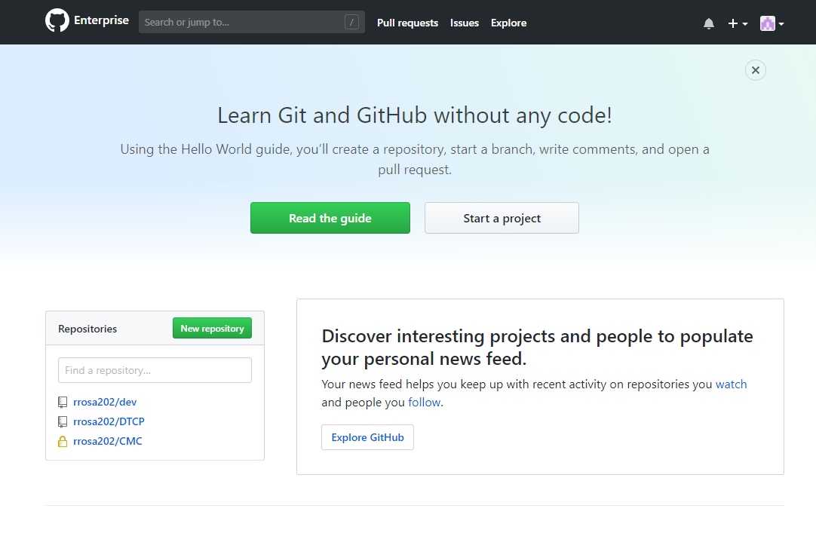
Creation of repository
Apply for access @ idm.cable.Comcast.com
Open and account with https://github.comcast.com/.
Example:
User: NTID, may skip the form, verify your e-mail.
Click on: Create a new repository.
Initialize with readme file.
Add git-ignore and create repo.
Click on: Clone or download.

Slide 11
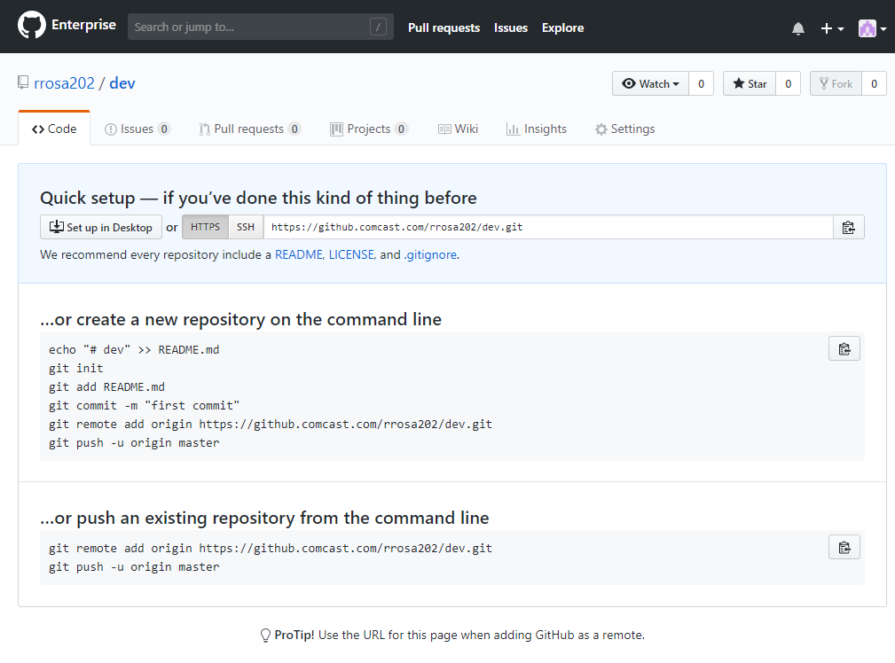
Installation @ local host
Linux Ubuntu run command:
Sudo apt-get install git
For windows:
http://git.scm.com/download/win
Create a directory and cd to it.
Generate your token:
https://github.comcast.com/settings/tokens
Clone the Github directory:
Sudo git clone https://github.com/rjrosag/dev.git
User: rrosa Password: <token>

Slide 12
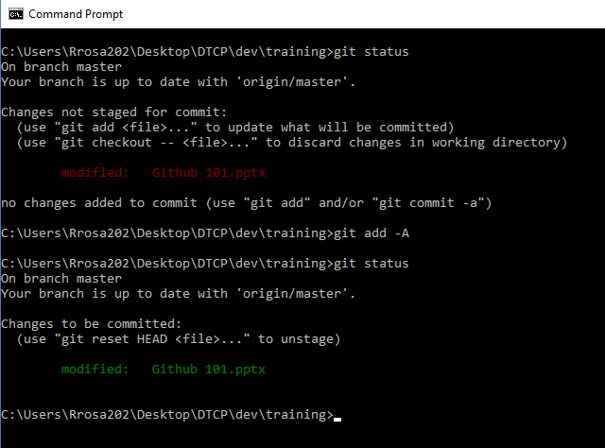
Adding files to repository
Use an editor to create a file, add some content and save it.
Stage the file: temporary local repo for modified files.
Sudo git status
Sudo git add –A or Sudo git add index.html
Sudo git status
Commit changes: candidates for publication.
Sudo git commit –m “My fist commit”
Sudo git –global user.email “rj.rosag@gmail.com”
Sudo git –global user.name “Robinson Rosa”

Slide 13
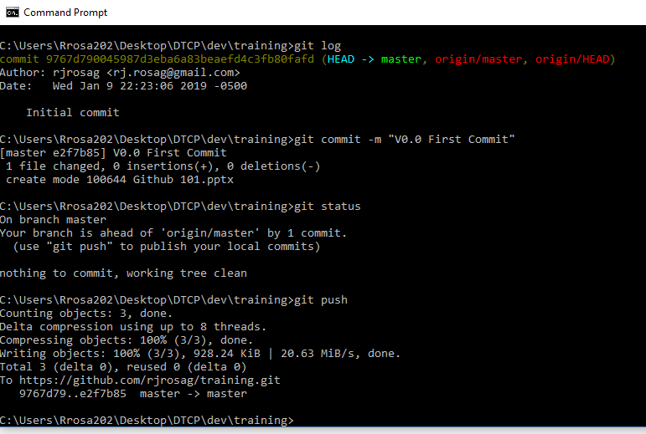
Adding files to repository
Publish your functional modules:
Sudo git status
Sudo git push –push-option = <Token>
Type: User / Password = token
Sudo git status

Slide 14
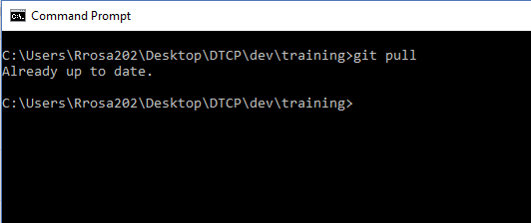
Extracting code from the Cloud repo
Sudo git pull
This command only works inside of git directory in your local host.

Slide 15
Best practices & help:
Best practices:
A) Git flow:
1) get the pulls at the beginning of your work day.
2) Make your changes and stage it:
Add commits throughout the day
3) Sync your files.
Every few hours sync the files.
B) Only publish completed/functional programs.
C) Comment to your first commit as follow:
git commit -m “v0.0 First commit”
For help just type:
Git

Slide 16
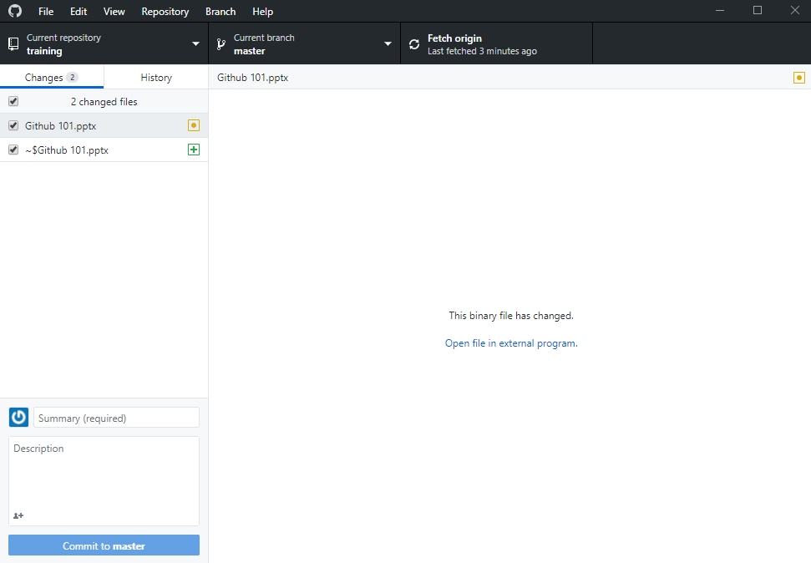
Git Desktop App

Slide 17
Q+A

Slide 18
In Summary
Today we used the following commands:
git status
git add -A
git commit -m
git push
git pull

Slide 19
Github 101
Next session content: “Github Intermediate”
Merge conflict
Local git repository initialization
Branching
Git graph
Fast forward merge & 3 way merge
Branches deletion
Detached head
Stash
Key configuration
Black listing
Head rebase

